Slide 1
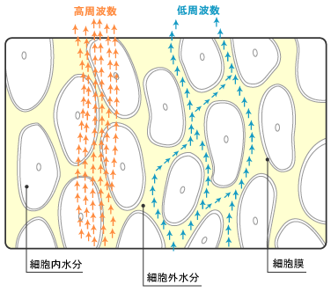
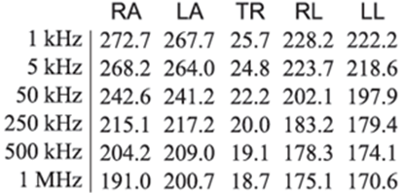
How to check Impedance measured by InBodyS10
Guide to evaluate measurement error
Impedance value is the raw data directly measured from InBody. Impedance indicates resistance which disturbs the flow of alternating current. InBody measures this impedance by flowing a broad range of alternating current to the body through body water, and interpreting the body composition by interpreting these values.
The measurement error can be detected by checking result sheet or LCD screen of InBodyS10.
InBody sends alternating currents from low (1kHz) to high (1,000kHz) frequency to the body, and the high frequency flows through the cell membrane and flows along the whole body water. On the other hand, low frequency mainly flows along the extracellular water due to the resistance of the cell membrane which leads to the higher impedance than that of high frequency.
Therefore, If the test is done in proper way, impedance is measured as above which reflects the characteristics of each frequency and body segment. In this background, the measurement error can be checked from the Impedance value in the right bottom of the result sheet or on a LCD result screen.
① Reversed Impedance in RA, LA, TR, RL, LL all between 5-500kHz
② Impedance over 50Ω in trunk, or over 700Ω in limb
③ Sudden drop of impedance in trunk (more than 10Ω), or in limb (more than 50Ω)
Even though it does not detect all the measurement errors, it can be used as an initial screening for odd values in body composition results. Because most of the measurement errors are caused by keratin and dryness, it can be solved by moisturizing electrode contacting point using electrolyte tissue. If error continues, attach teared electrolyte tissue directly to the electrode.
※ Trunk impedance is frequently reversed between 1~5kHz, and 500~1,000kHz especially for the patients with ascites or pleural effusion. Generally, the impedance is low when the water is high, and the impedance of the body is measured very low for the ascites and pleural effusion because the water is accumulated in trunk area. It happens because the characteristics of 1~5kHz, 500~1,000kHz is very similar and therefore, the data in this cas is normally used.

Slide 2

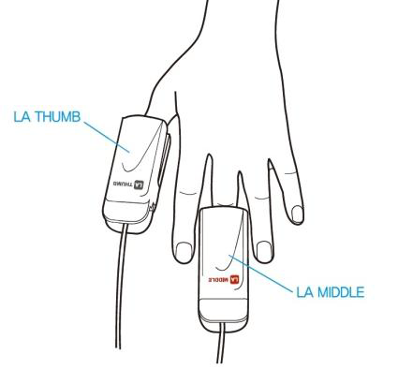

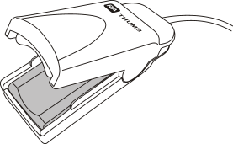

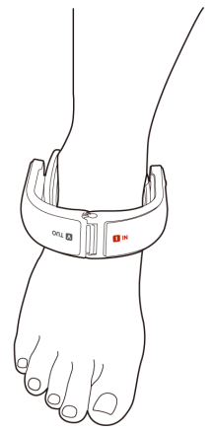
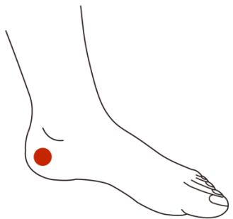
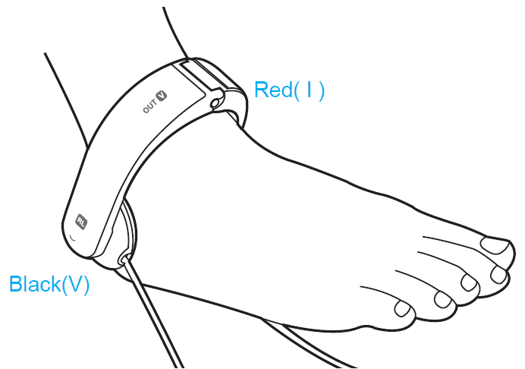
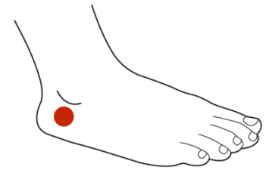

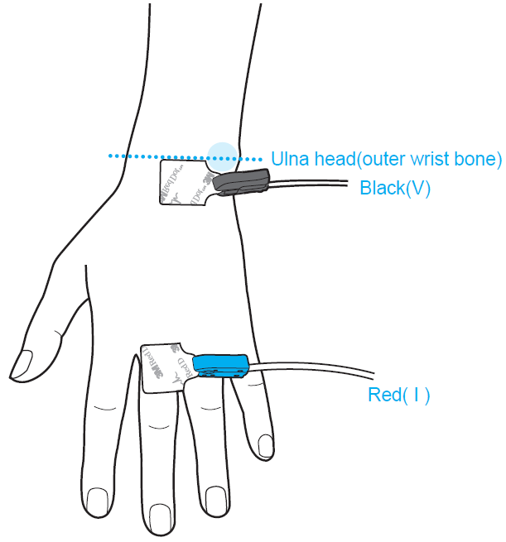
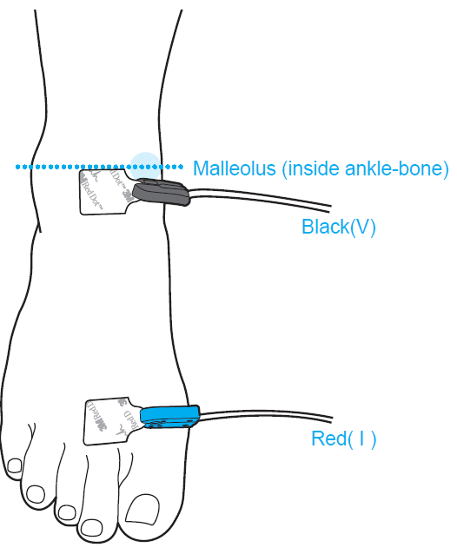

How to connect the InBodyS10 electrodes
Touch type and Adhesive type
How to connect touch type
1. Hand electrodes
LA: connect to Left Arm. RA: connect to Right Arm
The hand electrodes are marked THUMB for the thumg and MIDDLE for the middle finger.
Let the finger print touches the aluminum electrodes,
not nail.
2. Foot electrodes
LL: connect to Left Leg. RL: connect to Right Leg
The foot electrodes should be positioned between examinee’s
anklebone and heel so that the widest and flattened area can be
touched by the electrodes.
If the examinee’s ankles are too thick to put
from top side of the foot, place it to the heel.
<Contact point for figer electorde>
<Contact point for the inner side of the feet>
<When electrodes are attached to the heel>
<Contact point for the outside of the feet>
How to connect adhesive type
Hand electrodes
Attach the EKG electrodes to the outer wrist bone, and the other electrode should be wrapped around the base of a middle fingner.
2. Foot electrodes
Attach EKG in the middle of the inside ankle-bone, and the
other electrode should be placed at the base of the second toe.
▶ Press Adhesive Type button to use EKG electordes ▶ Connect Cable after attaching ECK electrodes
▶ Use EKG electrodes with CE certification. Once used, the EKG electrode should be discarded.
▶EKG electrodes can be used to arm and leg amputated patients.

Slide 3

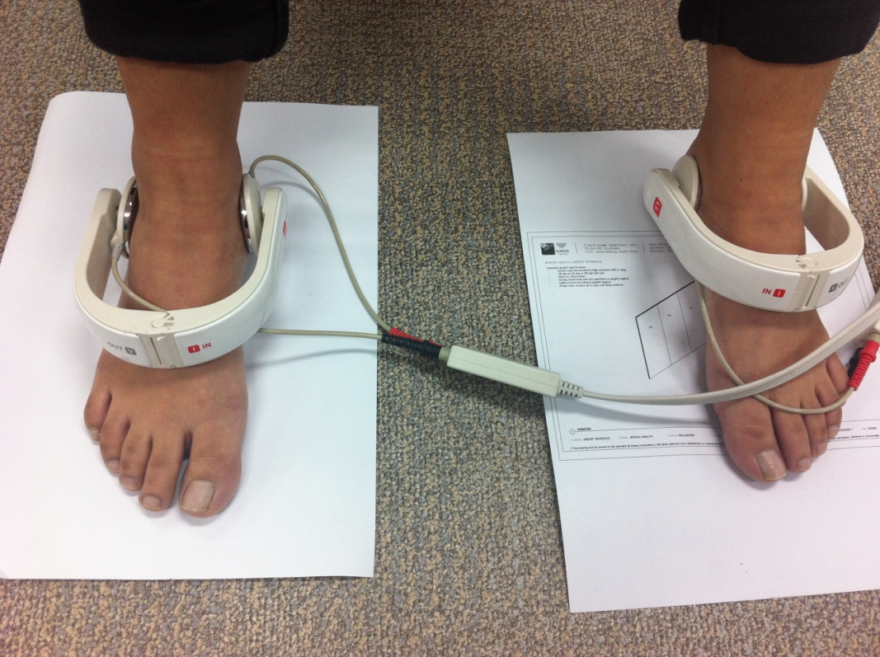
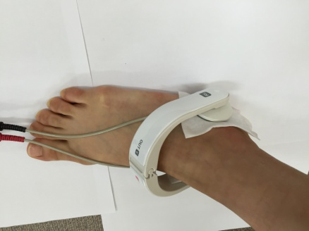
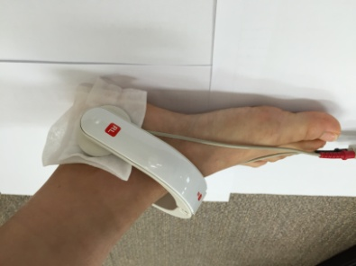
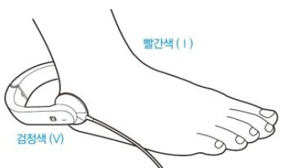
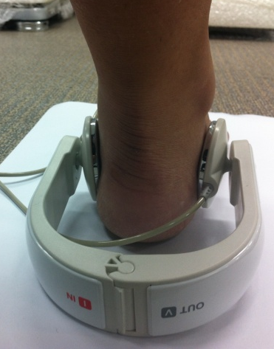
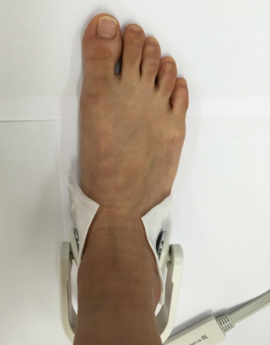
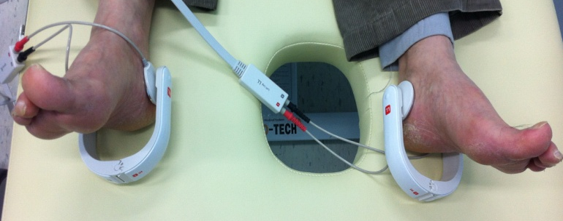
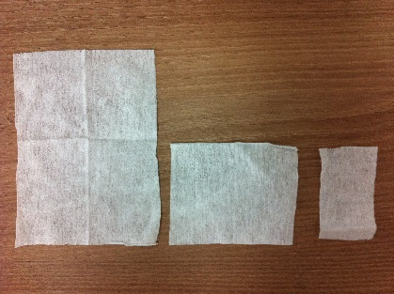

How to connect InBodyS10 foot electrodes
Moisten the bottom of the ankle-bone with InBody Tissue and make sure that it is correctly conatacted.
InBody Tissue
<Contact point for the inner side of the feet>
<Contact point for the outside of the feet>
Make sure the attached tissues separate each other.
<Electrodes from the back side>
※ If the skin on the contact area is very dry or very rough, cut electrode tissue as below picture and put it inside and outside before doing measurement. Make sure tissues do not touch each other.
<Lying Posture, electrodes from the backside>
Teared InBody Tissue

Slide 4
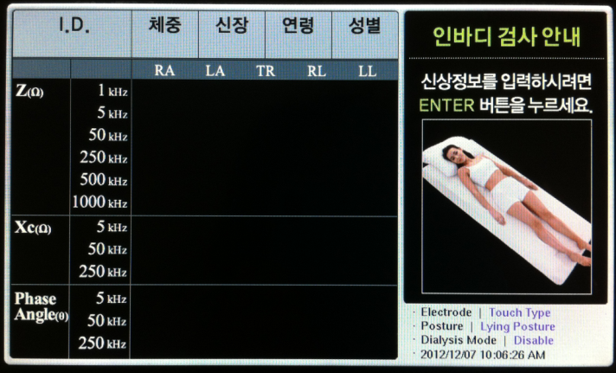
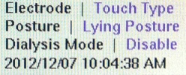
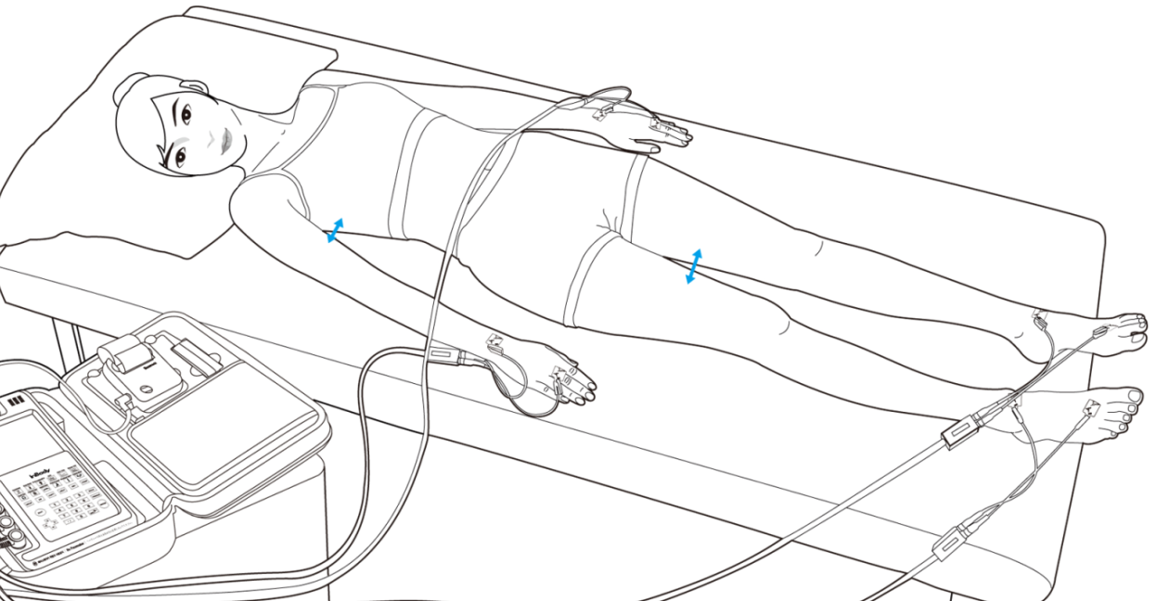
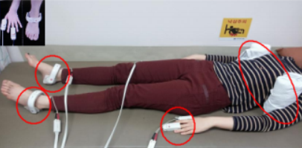
Cautions when measuring intensive care patients with InBodyS10
How to check Junk data
Measurement Protocol
1) Initial Screen
① Press ‘Enter’ at the front page and type in ID, Weight, Height, Age, Gender (Male / Female) using touch screen or key pad.
② BIA devices like InBody calculate Body Water by dividing height² with impedance (TBW=L²/Z) and calculate Body Fat by subtracting Fat Free mass from the total weight. Therefore, it is important to enter precise height and weight.
③ Select measurement mode as Touch type, Lying posture, and disable Dialysis mode.
2) Measurement posture and how to connect electrodes
① Moisten contact point (Thumb, middle finger, and base part of the ankle bone.) with InBody tissue. Make sure tissues do not touch each other. (If the patient is hard to maintain the posture, put blanke or pillow between armpit or legs to make each body segment separate).
② Make sure not to talk or move during the test. If error keeps come out, use gloves, clothes, and blankets to make body segment separate.
③ It is recommended to measure at the same time as possible.

Slide 5
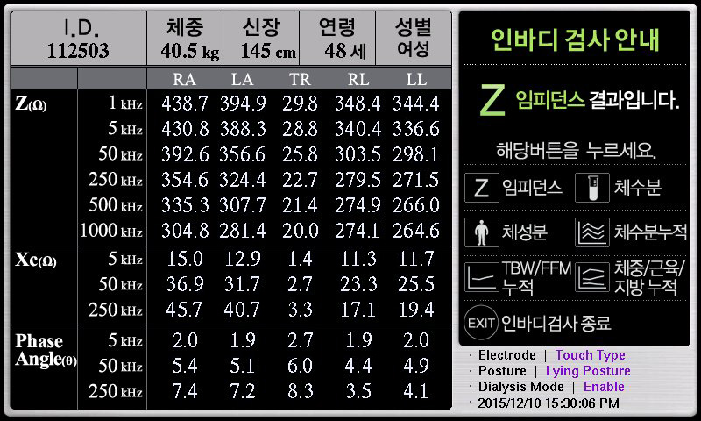
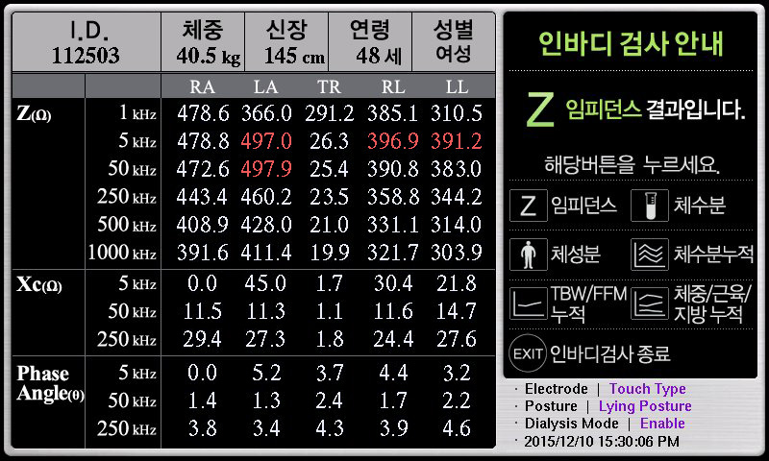
Cautions when measuring intensive care patients with InBodyS10
How to check Junk data
2. LCD
Impedance without error
Impedance with an error

Slide 6
Cautions when measuring intensive care patients with InBodyS10
How to check Junk data
3. Most common errer
Reverse in low frequency
① Reverse in the low frequency occurs when skin of the contact point is dry. Moisten the contact point with InBody tissue and try measurement again.
② Check whether the hand/foot electrodes are in proper contact with correct location.
2) Reverse in high frequency
① Impedance can be reversed because of the surrounding noise. Ensure the device to be connected to an outlet without ground terminal or not to be located close to the medical equipment that may cause electrical interference.
② If several devices are connected to the same outlet, disconnect them and plug into the different outlets.
③ Check if the patient has medical issues in that part of the body.
 | RA | LA | TR | RL | LL
1kHz | 435.6 | 404.7 | 21.0 | 209.3 | 163.7
5kHz | 442.1 | 397.5 | 13.9 | 161.1 | 155.7
50kHz | 419.6 | 382.4 | 12.4 | 147.8 | 155.7
250kHz | 395.0 | 362.7 | 12.0 | 140.7 | 142.6
500kHz | 381.0 | 349.7 | 12.0 | 137.1 | 139.1
1MHz | 359.3 | 326.6 | 12.0 | 130.8 | 132.6
 | RA | LA | TR | RL | LL
1kHz | 662.8 | 695.8 | 36.5 | 618.5 | 608.7
5kHz | 646.5 | 667.4 | 34.6 | 605.4 | 595.3
50kHz | 622.7 | 613.1 | 30.9 | 583.1 | 579.3
250kHz | 590.9 | 584.9 | 28.6 | 588.2 | 565.9
500kHz | 569.8 | 566.5 | 27.5 | 597.6 | 555.5
1MHz | 529.4 | 528.9 | 25.8 | 550.3 | 538.3

Slide 7
Cautions when measuring intensive care patients with InBodyS10
How to check Junk data
3. Most common error
3) Reverse in trunk
① When impedance is reversed in trunk, Medical issue needs to be checked. Laparotomy, and use of a catheter can lead to the reverse of TR impedance and the data cannot be used in this case.
② Reversion in 1~5kHz, 500~1,000kHz are frequent in patients with ascites and pleural effusion. Generally, the impedance is low when the water is high, and the impedance of the body is measured very low for the ascites and pleural effusion because the water is accumulated in trunk area. It happens because the characteristics of 1~5kHz, 500~1,000kHz is very similar and therefore, the data in this cas is normally used.
 | RA | LA | TR | RL | LL
1kHz | 795.2 | 834.2 | 21.9 | 591.6 | 585.2
5kHz | 782.0 | 820.2 | 20.6 | 579.6 | 573.5
50kHz | 763.3 | 800.3 | 20.5 | 562.5 | 556.3
250kHz | 741.5 | 775.7 | 22.7 | 544.7 | 539.7
500kHz | 715.6 | 749.0 | 27.1 | 530.0 | 525.1
1MHz | 656.6 | 691.1 | 27.1 | 500.2 | 494.3
 | RA | LA | TR | RL | LL
1kHz | 344.9 | 359.0 | 11.2 | 141.1 | 139.8
5kHz | 338.0 | 352.0 | 11.1 | 138.4 | 138.0
50kHz | 307.8 | 324.3 | 11.0 | 127.4 | 128.0
50kHz | 280.2 | 297.4 | 10.4 | 117.6 | 118.5
500kHz | 268.5 | 286.3 | 10.6 | 114.6 | 115.7
1MHz | 253.6 | 268.6 | 10.6 | 111.7 | 113.4
※ Ascites patient, data can be used

Slide 8
Cautions when measuring intensive care patients with InBodyS10
How to check Junk data
4. Impedance in ICU patient
Big impedance reverse
Impedance reverse over 2Ω in the trunk, and over 20Ω in the arms and legs should be re-measured.
2) Impedance difference over 100Ω between right/left
These are frequently seen in amputee patients. It tends to be low because of the physical characteristics of impededance that shorter the length, lower the impedance value. It can also be seen such as lymphedema or ICU patients whose specific body part is severely overhydrated or the circulation is very bad. All three cases can be used if there is no reverse in impedance.
 | RA | LA | TR | RL | LL
1kHz | 245.4 | 205.3 | 12.1 | 280.9 | 287.4
5kHz | 243.9 | 204.2 | 14.0 | 278.0 | 284.2
50kHz | 234.4 | 194.4 | 26.9 | 262.0 | 247.2
250kHz | 219.6 | 180.9 | 74.7 | 243.9 | 130.5
500kHz | 212.2 | 175.1 | 90.4 | 237.0 | 83.2
1MHz | 202.4 | 166.7 | 90.4 | 228.5 | 53.0
 | RA | LA | TR | RL | LL
1kHz | 201.8 | 213.9 | 24.2 | 90.9 | 231.2
5kHz | 198.1 | 210.1 | 23.4 | 89.4 | 227.5
50kHz | 176.9 | 191.1 | 21.1 | 83.1 | 206.4
250kHz | 159.1 | 174.1 | 18.8 | 77.5 | 191.7
500kHz | 153.3 | 168.3 | 18.0 | 76.0 | 187.0
1MHz | 147.9 | 162.9 | 17.6 | 74.3 | 182.6

Slide 9
Cautions when measuring intensive care patients with InBodyS10
How to check Junk data
4. Impedance in ICU patient
3) Decrease more than 10Ω in trunk or 50Ω in arms and legs
Generally, arm impedance is 300~500Ω, trunk impedance is 10~40Ω, leg impedance is 200~300Ω. When ICU patient is severely overhydrated, impedance can be lower than the normal range. Even if there is no reverse, if the impedance drop more than 10 ohms in trunk and 50 ohms in limbs, re-measure the patient.
 | RA | LA | TR | RL | LL
1kHz | 546.8 | 492.0 | 51.4 | 435.1 | 452.2
5kHz | 533.0 | 484.7 | 47.8 | 424.3 | 442.0
50kHz | 482.8 | 451.6 | 38.6 | 385.5 | 403.0
250kHz | 392.8 | 428.0 | 28.7 | 358.9 | 375.2
500kHz | 301.6 | 410.7 | 24.0 | 348.3 | 362.5
1MHz | 198.1 | 382.4 | 19.5 | 338.2 | 347.3
 | RA | LA | TR | RL | LL
1kHz | 150.4 | 150.1 | 10.6 | 125.0 | 109.6
5kHz | 137.8 | 121.8 | 8.2 | 123.8 | 107.6
50kHz | 115.5 | 46.2 | 4.0 | 119.0 | 102.0
250kHz | 102.9 | 24.9 | 3.2 | 119.0 | 102.0
500kHz | 99.7 | 19.8 | 3.1 | 109.4 | 93.6
1MHz | 91.1 | 12.9 | 2.9 | 104.2 | 89.0

Slide 10
Check factors affecting measurement in an ICU environment
How to check Junk data
5. Check factors affecting measurement in an ICU environment
Release you blood pressure monitor
Remove pressing bandages〮pressure stockings or intermittent pneumatic massagers.
Error can occur when the test is done during CRRT.
Make sure the electordes and body do not touch the bed frame during the test.
Patient Monitor, sap automatic injector, Ventilator, and etc do not effect InBody test. But, the wave in patient monitor can be affected by the frequencies from InBody.
Make arm and trunk / each leg separate, but inconvenient posture can make the patient to move which causes impedance error. In this case, use pillow or blanket to make each segment separate instead of forcing patient to do so. Especially when the patient is wearing a skirt, make sure each leg to be separated.
When other devices are attached on the middle finger, the ring finger or the little finger can be used for InBody electrode. However, when the thumb cannot be used, use ECG electrodes.

Slide 11
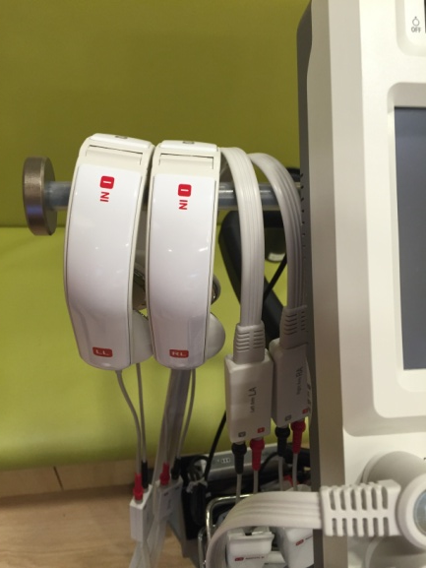
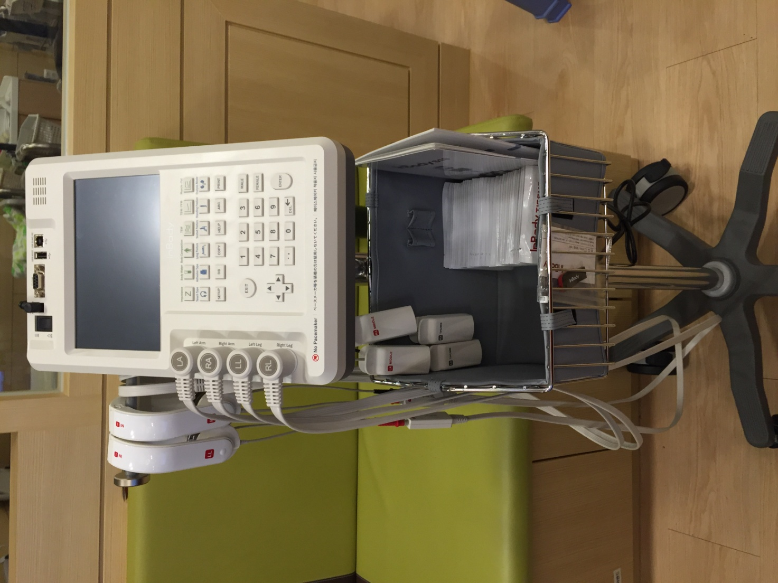
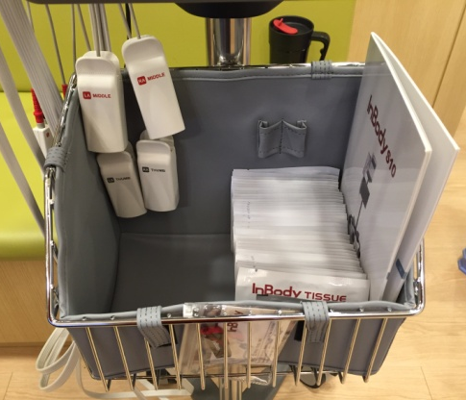
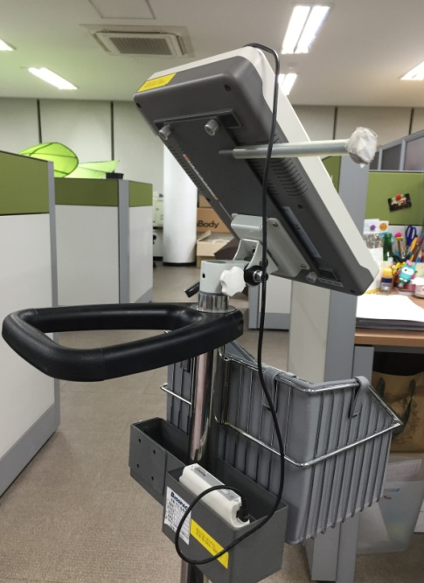
How to clean up InBodyS10
After use, hand and foot electrode should be arranged separately that the cables are not twisted each other.
Make sure the cables are not twisted each other, Hang hand electrodes inside, and put foot to the outside so that the electrodes do not fall.
In the basket, you may put
S10 manual, InBody tissues and USB.
Battery pack can be placed in the backside asket, and please charge all the time even during the device is not being used.

